Slide 1
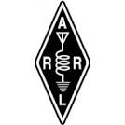

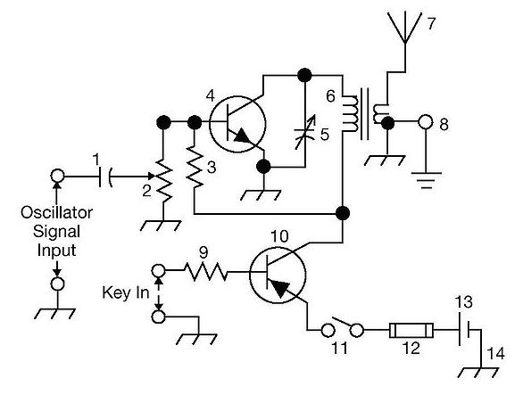
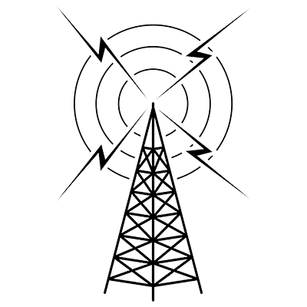
THE
ARRL
TENTH EDITION
GENERAL CLASS
LICENSE COURSE
FOR
HAM RADIO
All You Need to Pass Your General Class Exam!

Slide 2
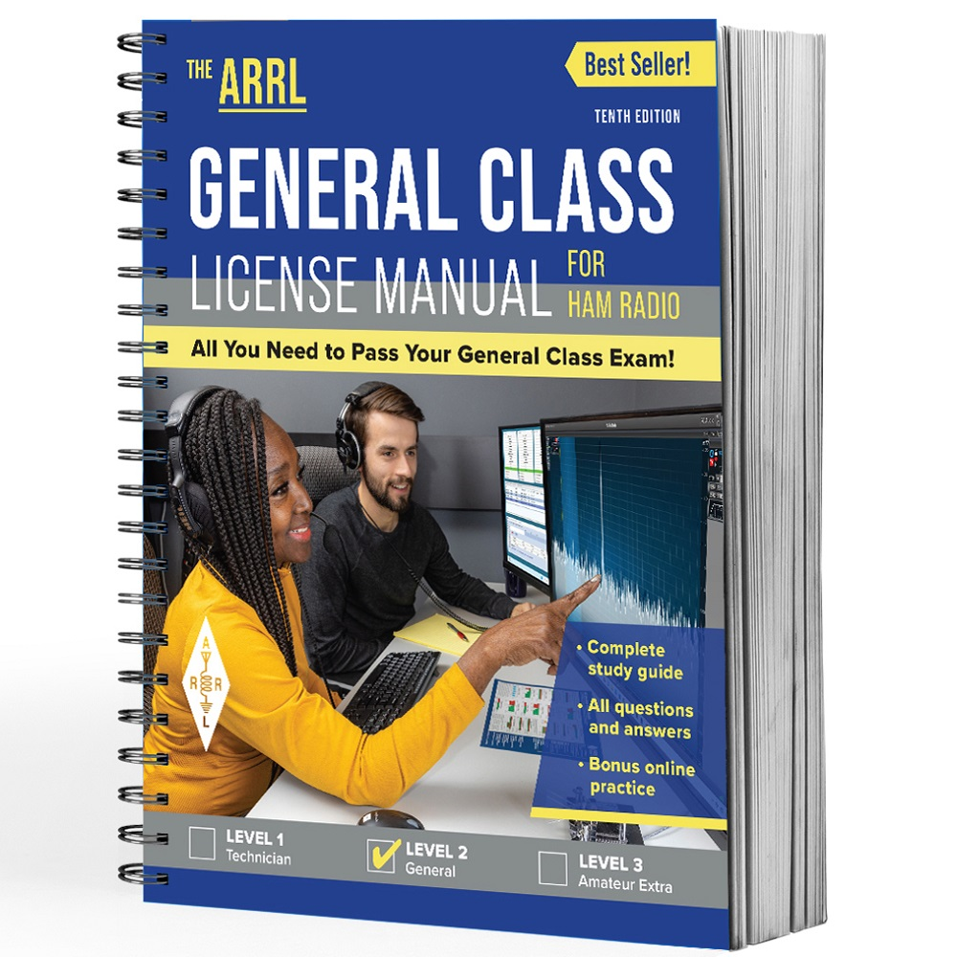

Resource & Reference
www.arrl.org/shop/Licensing-Education-and-Training

Slide 3
Chapter 4 Part 3 of 3
ARRL General Class
Components and Circuits
Sections 4.6, 4.7
Practical Circuits, Basic Test Equipment

Slide 4
Section 4.6
Practical Circuits: Rectifiers
Amateur radio electronic equipment requires dc power, so a power supply is required to run it from household ac power
  Most amateur equipment uses dc power at 13.8 V (chosen to be compatible with vehicle power systems)
Power supplies have 3 basic parts …
  Input transformer, rectifier, and filter-regulator output circuit

Slide 5
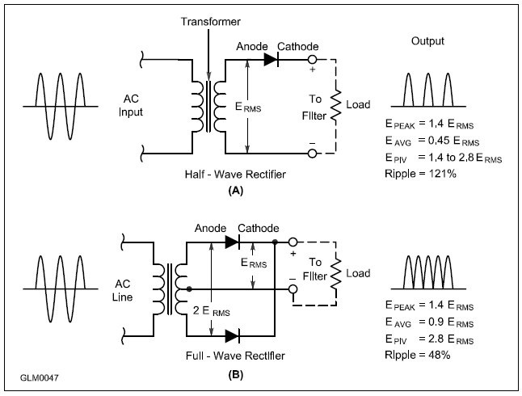
Rectifier Circuits
Figure 4.24: Basic Rectifier Circuits (half-wave & full wave)
Half-Wave Rectifier. Converts only one-half of the input waveform (180°). This creates a series of pulses of current in the load at the same frequency as the input voltage.
Full-Wave Rectifier. Converts entire input waveform (360°). This is really 2 half-wave rectifiers operating on alternate half cycles. Requires that the transformer be center-tapped to provide a return path for current flowing to the load.

Slide 6
Rectifiers (cont.)
The advantage of the full-wave rectifier is that output is produced during the entire 360° of the wave cycle (more efficient)
The output from full-wave rectifiers is a series of pulses at TWICE the frequency of the input voltage

Slide 7
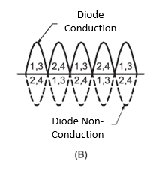
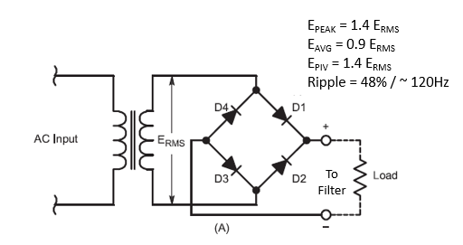
Full-Wave Bridge (Fig 4.25)
Another type of full-wave rectifier. This circuit adds 2 diodes (total of 4), but eliminates the need for a center-tapped winding.

Slide 8
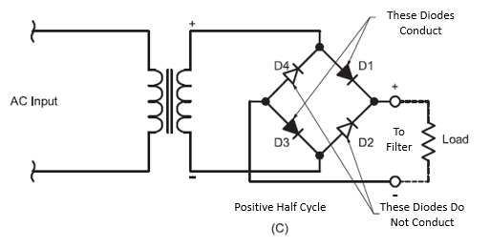
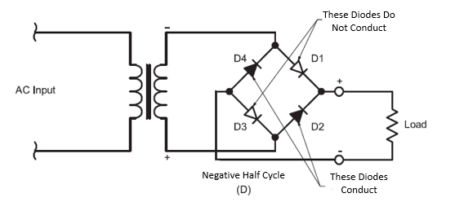
Full-Wave Bridge, cont. (Fig 4.25)
Another type of full-wave rectifier. This circuit adds 2 diodes (total of 4), but eliminates the need for a center-tapped winding.

Slide 9
Power Supply Filter Circuits
Rectifier’s output pulses of dc current don’t provide a stable voltage for direct use by electronic circuits
The variation in output voltage is called ripple
Pulses must be smoothed out by a filter network … consists of capacitors or capacitors AND inductors
Most common way to reduce ripple is a filter capacitor or capacitor-input filter
Older high-voltage circuits may use choke inductors

Slide 10
Power Supply Safety
Fuses in the primary are used to protect against short circuits or excessive current loads
Bleeder resistors discharge stored energy when the supply is turned off
Working on power supplies – wait for the bleeder resistor to discharge energy, even if it is unplugged

Slide 11
Switchmode or Switching Supplies (see Fig 4.27)
AC input is first rectified and filtered
Transistor switch pulses at high-frequency (20 kHz or more) to transfer energy to a filter capacitor (smoothes out ripple)
High frequency enables power supply to quickly change to current demands and means that small, lightweight inductors & capacitors can be used to filter the output

Slide 12
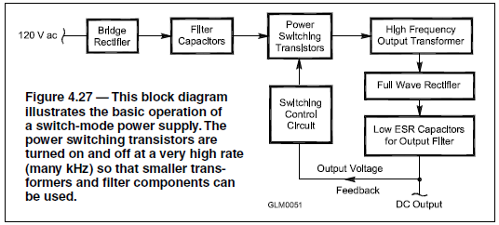
Switchmode or Switching Supplies (cont.)
AC input is first rectified and filtered. Transistor switch then supplies current pulses to a small inductor or transformer, which transfers the energy into another filter capacitor that smoothes the pulses for a steady output voltage. The high frequency of the pulses means that the supply can react quickly to changing current demands. The high frequency also means that small, lightweight inductors and capacitors can be used to smooth the pulses and filter the output.

Slide 13
PRACTICE QUESTIONS

Slide 14
What is the function of a power supply bleeder resistor?
It acts as a fuse for excess voltage
It discharges the filter capacitors when power is removed
It removes shock hazards from the induction coils
It eliminates ground loop current
G7A01 (B) Page 4-36
14

Slide 15
Which of the following components are used in a power supply filter network?
Diodes
Transformers and transducers
Capacitors and inductors
All these choices are correct
G7A02 (C) Page 4-35
15

Slide 16
Which type of rectifier circuit uses two diodes and a center-tapped transformer?
Full-wave
Full-wave bridge
Half-wave
Synchronous
G7A03 (A) Page 4-35
16

Slide 17
What is characteristic of a half-wave rectifier in a power supply?
Only one diode is required
The ripple frequency is twice that of a full-wave rectifier
More current can be drawn from the half-wave rectifier
The output voltage is two times the peak input voltage
G7A04 (A) Page 4-35
17

Slide 18
What portion of the AC cycle is converted to DC by a half-wave rectifier?
90 degrees
180 degrees
270 degrees
360 degrees
G7A05 (B) Page 4-35
18

Slide 19
What portion of the AC cycle is converted to DC by a full-wave rectifier?
90 degrees
180 degrees
270 degrees
360 degrees
G7A06 (D) Page 4-35
19

Slide 20
What is the output waveform of an unfiltered full-wave rectifier connected to a resistive load?
A series of DC pulses at twice the frequency of the AC input
A series of DC pulses at the same frequency as the AC input
A sine wave at half the frequency of the AC input
A steady DC voltage
G7A07 (A) Page 4-35
20

Slide 21
Which of the following is characteristic of a switchmode power supply as compared to a linear power supply?
Faster switching time makes higher output voltage possible
Fewer circuit components are required
High-frequency operation allows the use of smaller components
Inherently more stable
G7A08 (C) Page 4-36
21

Slide 22
Batteries & Chargers
Two battery types: primary and secondary
Primary
  Disposable, discarded after discharging
  Battery chemistry: carbon-zinc, alkaline, silver-nickel
  Preferable to secondary batteries for emergency operation because ac power may not be available for charging
Secondary
  Can be recharged/reused many times
  Battery chemistry: nickel-cadmium (NiCd), nickel-metal hydride (NiMH), lithium-ion (Li-ion), lead-acid

Slide 23
Table 4.8: Battery Types & Characteristics
BATTERY STYLE | CHEMISTRY | TYPE | FULL-CHARGE (V) | ENERGY RATING (mAh)
AAA | Alkaline | Disposable | 1.5 | 1100
AA | Alkaline | Disposable | 1.5 | 2600-3200
AA | Carbon-Zinc | Disposable | 1.5 | 600
AA | Nickel-Cadmium (NiCd) | Rechargeable | 1.2 | 700
AA | Nickel-Metal Hydride (NiMH) | Rechargeable | 1.2 | 1500-2200
AA | Lithium | Disposable | 1.7 | 2100-2400
C | Alkaline | Disposable | 1.5 | 7500
D | Alkaline | Disposable | 1.5 | 14,000
9 V | Alkaline | Disposable | 9 | 580
9 V | Nickel-Cadmium (NiCd) | Rechargeable | 9 | 110
9 V | Nickel-Metal Hydride (NiMH) | Rechargeable | 9 | 150
Coin Cells | Lithium | Disposable | 3-3.3 | 25-1000

Slide 24
Storage Batteries (Larger Secondary Batteries)
Used for emergency or portable power to replace power supplies operating from ac power
Battery chemistry: lead-acid, liquid electrolyte, gel electrolyte (gel-cells)
Rated as “12 V” batteries, but are actually 13.8 V
Lead-acid batteries can produce useful power down to 10.5 V
Discharging below minimum voltage will reduce battery life

Slide 25
Batteries (cont.)
Limiting amount of current drawn keeps battery cool and extends life
Some battery types (NiCds) are designed to have low internal resistance to supply high discharge currents
Batteries slowly lose charge when not in use ... called self-discharge (minimize by keeping battery cool & dry, but avoid freezing … expanding water can crack the case or damage electrodes)

Slide 26
Alternative Power
Solar Power: photovoltaic conversion of sunlight to electricity … solar panels/cells are special type of diode (silicon PN-junctions)
In solar cells, photons are absorbed by electrons giving them enough energy to travel across the PN junction and create dc current flow … the forward voltage created (≈0.5V) is called the open-circuit voltage
Wind/solar power systems require substantial energy storage
When connecting a solar panel to a lithium iron phosphate battery, use a charge controller to avoid overcharging the battery
Solar connections are made through a series-connected diode to prevent battery from discharging back through the panel during periods of low illumination / reduced voltage
Solar panels and solar cells are made of silicon PN-junctions that are exposed to sunlight and arranged in a series-parallel configuration

Slide 27
PRACTICE QUESTIONS

Slide 28
In what configuration are the individual cells in a solar panel connected together?
Series-parallel
Shunt
Bypass
Full-wave bridge
G4E08 (A) Page 4-39
28

Slide 29
What is the approximate open-circuit voltage from a fully illuminated silicon photovoltaic cell?
0.02 VDC
0.5 VDC
0.2 VDC
1.38 VDC
G4E09 (B) Page 4-39
29

Slide 30
Why should a series diode be connected between a solar panel and a storage battery that is being charged by the panel?
To prevent overload by regulating the charging voltage
To prevent discharge of the battery through the panel during times of low or no illumination
To limit the current flowing from the panel to a safe value
To prevent damage to the battery due to excessive voltage at high illumination levels
G4E10 (B) Page 4-39
30

Slide 31
What precaution should be taken when connecting a solar panel to a lithium iron phosphate battery?
Ground the solar panel outer metal framework
Ensure the battery is placed terminals-up
A series resistor must be in place
The solar panel must have a charge controller
G4E11 (D) Page 4-39
31

Slide 32
What is the minimum allowable discharge voltage for maximum life of a standard 12-volt lead-acid battery?
6 volts
8.5 volts
10.5 volts
12 volts
G6A01 (C) Page 4-39
32

Slide 33
What is an advantage of batteries with low internal resistance?
Long life
High discharge current
High voltage
Rapid recharge
G6A02 (B) Page 4-39
33

Slide 34
Connector Terminology
Pins: contacts that extend out of the connector body (male)
Sockets: hollow, recessed contacts (female)
Keyed connectors: specially shaped (bodies or inserts) to prevent damage from connecting incorrectly
Plugs: connectors installed on ends of cables
Jacks/receptables: connectors installed on equipment
Adapters: make connections between 2 different connector styles
Splitters: divide signals between 2 connectors

Slide 35
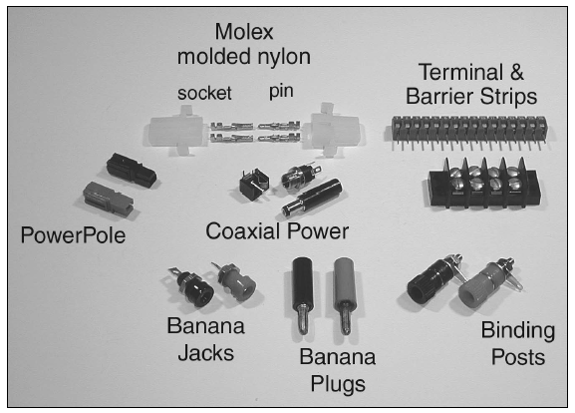
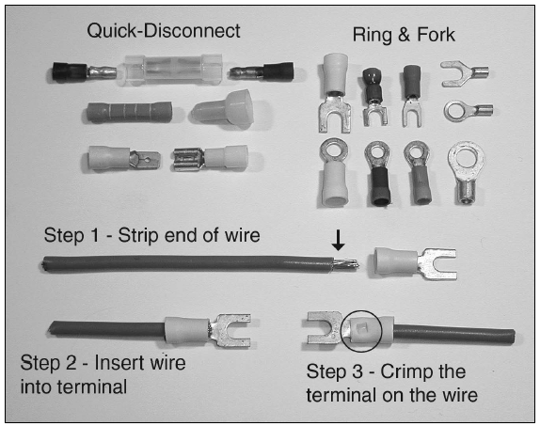
Power Connectors
Fig 4.28: Connectors used on amateur equipment
Fig 4.29: Terminals that are crimped to ends of wires

Slide 36
Power Connectors (cont.)
Anderson Powerpole connectors have become the standard used by ARES
  Anderson connectors are “sexless” … by standardizing on a single style, equipment can be easily shared and replaced
Note that these (see previous figure) are crimp terminals … special crimping tools are used for attaching the wire to the terminal (avoid using pliers or other tools for making these connections)

Slide 37
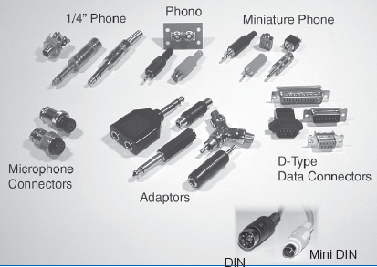
Audio Connectors
Come in ¼-inch, ⅛-inch (miniature), and subminiature varieties
Contact at end of plug is the tip
Connector at base of plug is the sleeve
3rd contact (if applicable) between tip and sleeve is the ring (also called TRS or tip-ring-sleeve)
Phono plugs/jacks (also called RCA connectors) are used for audio, video and low-level RF signals & control signals
Fig. 4.30: Samples of audio connectors

Slide 38
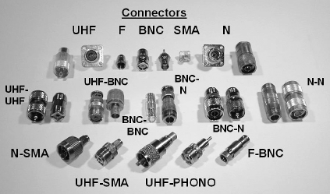
RF Connectors
Fig. 4.31: Each type of RF connector is specially made to carry RF signals and preserve the shielding of coaxial cable. Adapters are available to connect one style of connector to another.

Slide 39
RF Connectors (cont.)
Radio signals require special connectors for use at RF frequencies
Connectors must have about the same impedance as the feed line (or some of the signal will be reflected by the connector)
Most common connector is the UHF family in Fig. 4.31 (UHF does not refer to ultra high frequency*)
UHF connectors are typically used up to 150 MHz and can handle legal-limit transmitter power at HF
* UHF connector design was named during an era when "UHF" meant frequencies over 30 MHz. Today, Ultra High Frequency refers to frequencies between 300 MHz and 3 GHz.

Slide 40
RF Connectors (cont.)
UHF connector drawbacks: lack of weather proofing, inconsistent performance above 150 MHz, limited power handling at higher frequencies
Type N series connectors address these drawbacks … can be used to 10 GHz
BNC connectors are used for low power (common in handhelds for antennas) … upper limit for low SWR operation is 4 GHz
SMA connectors are small threaded connectors designed for miniature coax, rated to 18 GHz ... also used for handheld antennas

Slide 41
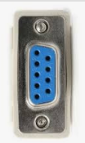
Data Connectors
Digital data is exchanged between computers and radio equipment more that ever before in amateur radio
D-type connectors are used for RS-232 (COM port) interfaces
The model number of a D-type connector specifies the number of circuits and a P or S depending upon whether the connector uses pins (male) or sockets (female). For example, D-type 9-pin connectors referred to as DB-9 or DE-9 are used for COM ports on PCs.
The D refers to its shape …

Slide 42
PRACTICE QUESTIONS

Slide 43
What is a typical upper frequency limit for low SWR operation of 50-ohm BNC connectors?
50 MHz
500 MHz
4 GHz
40 GHz
G6B04 (C) Page 4-42
43

Slide 44
Which of the following describes a type N connector?
A moisture-resistant RF connector useful to 10 GHz
A small bayonet connector used for data circuits
A low noise figure VHF connector
A nickel plated version of the PL-259
G6B07 (A) Page 4-42
44

Slide 45
What is an SMA connector?
A type-S to type-M adaptor
A small threaded connector suitable for signals up to several GHz
A connector designed for serial multiple access signals
A type of push-on connector intended for high-voltage applications
G6B11 (B) Page 4-42
45

Slide 46
Which of these connector types is commonly used for low frequency or dc signal connections to a transceiver?
PL-259
BNC
RCA Phono
Type N
G6B12 (C) Page 4-41
46

Slide 47
Section 4.7
Basic Test Equipment: Analog & Digital Meters
A volt-ohm-meter (a.k.a. VOM or multimeter) is the simplest and very versatile piece of test equipment … two types: analog and digital
Functions: measures voltage, measures current, measures resistance, checks continuity, tests diodes, tests transistors, frequency counter, measures capacitance, measures inductance, and interfaces to PCs to record readings

Slide 48
Analog & Digital Meters (cont.)
Digital multimeters (DMM) offer greater precision than analog meters
For finding a peak or minimum reading (for example, when adjusting or tuning a circuit)
Experienced hams often prefer analog meters (easier to just watch the analog meter needle move than the display on a digital meter)
Meters should affect the circuit being measured to the smallest degree possible. When measuring voltage, meters should have a high input impedance so that it places the minimum load on the circuit.

Slide 49
Oscilloscope (or Scope)
Provides visual display of voltage against time
Display is updated thousands or millions of times per second to give a real-time view of the signal’s characteristics (allows for measurement of fast-changing waveforms that can’t be measured by other meters).
Signals are connected to the scope through horizontal and vertical channel amplifiers. Amplifier gain is variable to adjust vertical sensitivity of the scope’s display.

Slide 50
Monitoring Oscilloscope
Used for monitoring transmitted signals by connecting the attenuated RF output of the transmitter to the vertical channel of the scope
  This assists in adjusting keying waveforms, microphone gain, and speech processing
  When adjusting keying waveforms (CW transmitter), operator can see (on scope’s display) the effects of any adjustments or conditions that might cause distortion or key clicks on the transmitted signal

Slide 51
Impedance & Resonance Measurements
An antenna analyzer contains a CW signal generator, frequency counter, SWR bridge, and impedance meter
  Connects to the antenna feed line to measure SWR without having to transmit a signal at high power
  Measures feed line velocity factor, electrical length, and characteristic impedance, and other parameters
  Because they use small signals, accuracy can be affected by strong signals from nearby transmitters

Slide 52
Field Strength & RF Power Meters
Other useful tests include antenna efficiency and radiation pattern; measured with a field strength meter
Field strength meters are often used for comparing relative levels of RF output during antenna and transmitter adjustments
Radiation pattern is measured by placing field strength meter in one location and rotating the antenna. Or, the meter can be carried to different locations to determine radiation pattern of a fixed antenna.

Slide 53
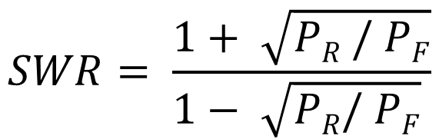
Field Strength & RF Power Meters (cont.)
Directional wattmeters measure both forward and reflected power (P_{F} and P_{R}) in the line
Standing wave ratio (SWR) can be calculated from forward and reflected power measurements:

Slide 54
PRACTICE QUESTIONS

Slide 55
What item of test equipment contains horizontal and vertical channel amplifiers?
An ohmmeter
A signal generator
An ammeter
An oscilloscope
G4B01 (D) Page 4-44
55

Slide 56
Which of the following is an advantage of an oscilloscope versus a digital voltmeter?
An oscilloscope uses less power
Complex impedances can be easily measured
Greater precision
Complex waveforms can be measured
G4B02 (D) Page 4-44
56

Slide 57
Which of the following is the best instrument to use when checking the keying waveform of a CW transmitter?
An oscilloscope
A field strength meter
A sidetone monitor
A wavemeter
G4B03 (A) Page 4-45
57

Slide 58
What signal source is connected to the vertical input of an oscilloscope when checking the RF envelope pattern of a transmitted signal?
The local oscillator of the transmitter
An external RF oscillator
The transmitter balanced mixer output
The attenuated RF output of the transmitter
G4B04 (D) Page 4-45
58

Slide 59
Why do voltmeters have high input impedance?
It improves the frequency response
It allows for higher voltages to be safely measured
It improves the resolution of the readings
It decreases the loading on circuits being measured
G4B05 (D) Page 4-43
59

Slide 60
What is an advantage of a digital voltmeter as compared to an analog voltmeter?
Better for measuring computer circuits
Less prone to overload
Higher precision
Faster response
G4B06 (C) Page 4-43
60

Slide 61
When is an analog multimeter preferred to a digital multimeter?
When testing logic circuits
When high precision is desired
When measuring the frequency of an oscillator
When adjusting circuits for maximum or minimum values
G4B09 (D) Page 4-43
61

Slide 62
Which of the following can be determined with a directional wattmeter?
Standing wave ratio
Antenna front-to-back ratio
RF interference
Radio wave propagation
G4B10 (A) Page 4-46
62

Slide 63
Which of the following must be connected to an antenna analyzer when it is being used for SWR measurements?
Receiver
Transmitter
Antenna and feed line
All these choices are correct
G4B11 (C) Page 4-45
63

Slide 64
What effect can strong signals from nearby transmitters have on an antenna analyzer?
Desensitization which can cause intermodulation products which interfere with impedance readings
Received power that interferes with SWR readings
Generation of harmonics which interfere with frequency readings
All these choices are correct
G4B12 (B) Page 4-45
64

Slide 65
Which of the following can be measured with an antenna analyzer?
Front-to-back ratio of an antenna
Power output from a transmitter
Impedance of coaxial cable
Gain of a directional antenna
G4B13 (C) Page 4-45
65

Slide 66
END OF CHAPTER 4 PART 3 OF 3

Slide 67
Slides created by …
Jerry D. Kilpatrick
KØILP (Amateur Radio)
PGØØØ72373 (Commercial Operator)
K0ILP.NC@gmail.com
Feel free to contact me if you find errors or have suggestions for improvement.

