Slide 1
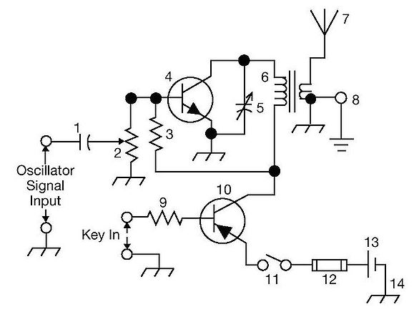
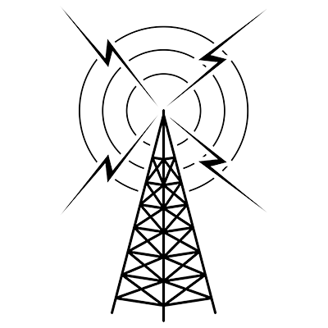
THE
ARRL
TENTH EDITION
GENERAL CLASS
LICENSE COURSE
FOR
HAM RADIO
All You Need to Pass Your General Class Exam!

Slide 2
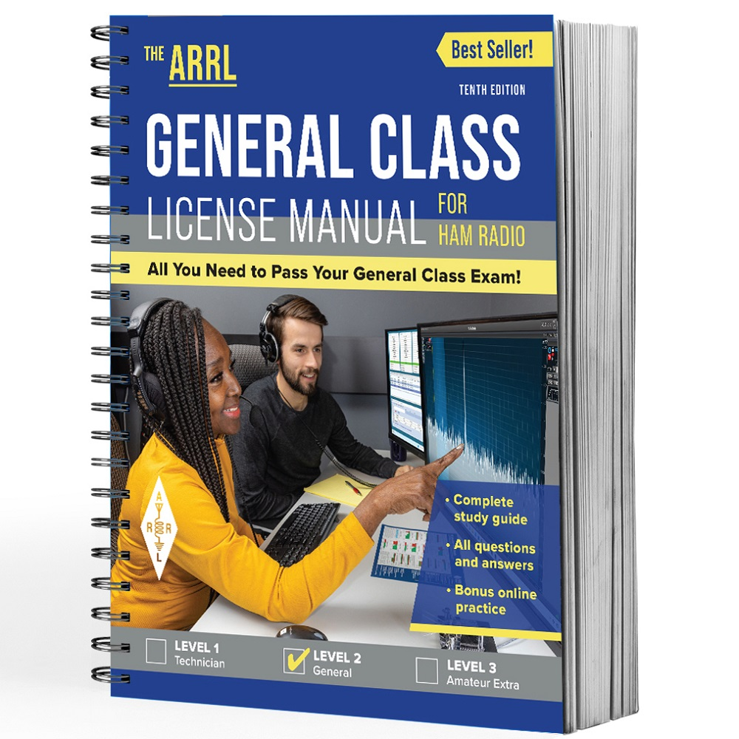
Resource & Reference
www.arrl.org/shop/Licensing-Education-and-Training

Slide 3
Chapter 3 Part 1 of 1 ARRL General Class Sections 3.1, 3.2, 3.3, 3.4 Regulatory Agencies, Amateur Licensing Rules, Control Operator Privileges & Rules, Technical Rules & Standards

Slide 4
Section 3.1 Regulatory Agencies
ITU: International Telecommunication Union
Responsible for all international radio regulations
Each country decides how to administer & implement regulations
Countries may impose additional regulations (as long as they don’t conflict with ITU rules)
3 administrative regions (next slide)
Individual regions have their greatest effect on amateurs in frequency allocations, and individual country allocations can also vary

Slide 5
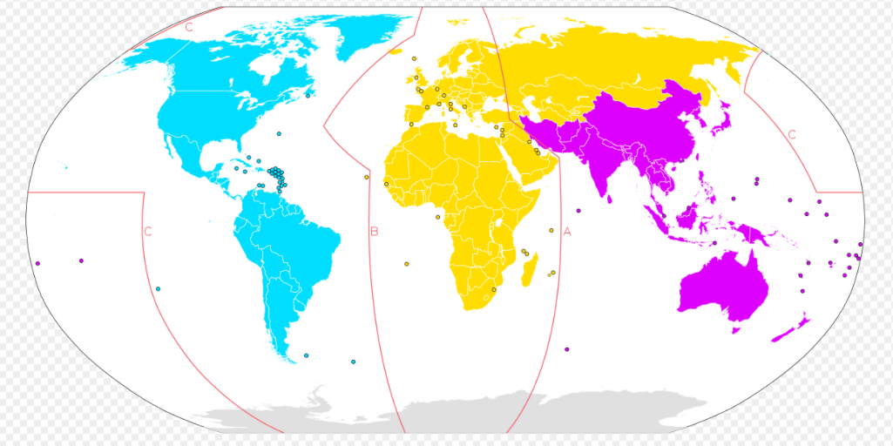
ITU Regions
REGION 1
REGION 2
REGION 3
North & South America, Alaska, Hawaii, and most US territories are in Region 2.

Slide 6
Regulatory Agencies (cont.)
FCC: Federal Communication Commission
Governed by Electronic Code of Federal Regulations Part 97
www.arrl.org/part-97-amateur-radio
Charged with writing and administering rules for US amateurs
FCC jurisdiction includes all US states, possessions, territories, and US-flagged vessels in international waters
This includes some US territories in Region 3 (American Samoa, Guam, etc.). These have the same rules as amateurs in Region 2.

Slide 7
FCC Volunteer Monitoring Program
Amateur Radio Service is self-policing
ARRL created the Amateur Auxiliary in 1982 so amateurs could assist FCC with enforcement (Official Observers) and interference issues (Local Interference Committees)
Official Observer Program changed to Volunteer Monitoring Program (VMP) in 2018 … Goals: self-regulation & compliance
VMP made up of volunteer amateurs, monitoring airwaves for rules violations

Slide 8
VMP (cont.)
Training activities for monitoring include …
Foxhunting
Radio direction-finding (RDF)
Used for quickly locating hidden transmitters
Volunteer monitors might use these skills to locate stations violating FCC rules, intentionally or not
More information …
www.homingin.com

Slide 9
Regulatory Agencies (cont.)
FAA: Federal Aviation Administration
FAA has jurisdiction over antenna structures more than 200 ft. high and within 4 miles of a public use airport or heliport
Must register such structures with FCC (to avoid aircraft hazards)
Local Building Authorities
Local building codes may apply to towers & antennas
FCC Rule PRB-1: Amateur Service communications must be reasonably accommodated … regulations must be the minimum practical and have legitimate purpose

Slide 10
PRACTICE QUESTIONS

Slide 11
What is the maximum height above ground for an antenna structure not near a public use airport without requiring notification to the FAA and registration with the FCC?
50 feet
100 feet
200 feet
250 feet
G1B01 (C) [97.15(a)] Page 3-3
11

Slide 12
Under what conditions are state and local governments permitted to regulate amateur radio antenna structures?
Under no circumstances, FCC rules take priority
At any time and to any extent necessary to accomplish a legitimate purpose of the state or local entity, provided that proper filings are made with the FCC
Only when such structures exceed 50 feet in height and are clearly visible 1,000 feet from the structure
Amateur Service communications must be reasonably accommodated, and regulations must constitute the minimum practical to accommodate a legitimate purpose of the state or local entity
G1B06 (D) [97.15(b), PRB-1, 101 FCC 2d 952 (1985)] Page 3-3
12

Slide 13
When operating a US station by remote control from outside the country, what license is required of the control operator?
A US operator/primary station license
Only an appropriate US operator/primary license and a special remote station permit from the FCC
Only a license from the foreign country, as long as the call sign includes identification of portable operation in the US
A license from the foreign country and a special remote station permit from the FCC
G1D05 (A) [97.7)] Page 3-2
13

Slide 14
When operating a station in South America by remote control over the internet from the US, what regulations apply?
Those of both the remote station’s country and the FCC
Those of the remote station’s country and the FCC’s third-party regulations
Only those of the remote station’s country
Only those of the FCC
G1D12 (C) [97.507] Page 3-5
14

Slide 15
The frequency allocations of which ITU region apply to radio amateurs operating in North and South America?
Region 4
Region 3
Region 2
Region 1
G1E06 (C) [97.301, ITU Radio Regulations] Page 3-2
15

Slide 16
What is the Volunteer Monitor Program?
Amateur volunteers who are formally enlisted to monitor the airwaves for rules violations
Amateur volunteers who conduct amateur licensing examinations
Amateur volunteers who conduct frequency coordination for amateur VHF repeaters
Amateur volunteers who use their station equipment to help civil defense organizations in times of emergency
G2D01 (A) Page 3-3
16

Slide 17
Which of the following are objectives of the Volunteer Monitor Program?
To conduct efficient and orderly amateur licensing examinations
To provide emergency and public safety communications
To coordinate repeaters for efficient and orderly spectrum usage
To encourage amateur radio operators to self-regulate and comply with the rules
G2D02 (D) Page 3-3
17

Slide 18
What procedure may be used by Volunteer Monitors to localize a station whose continuous carrier is holding a repeater on in their area?
Compare vertical and horizontal signal strengths on the input frequency
Compare beam headings on the repeater input from their home locations with that of other Volunteer Monitors
Compare signal strengths between the input and output of the repeater
All these choices are correct
G2D03 (B) Page 3-3
18

Slide 19
Section 3.2 Amateur Licensing Rules
Volunteer Examiner Rules
Volunteer licensing program is administered by Volunteer Examiner Coordinators (VECs)
VECs have agreements with FCC to coordinate examinations
VE accreditation requirements
Be accredited by a VEC
Be at least 18 years of age
Hold a General class or higher license
Have never had your license suspended or revoked
Pass a multiple-choice, open-book exam
No cost!
Allows you to administer exams

Slide 20
Examination Rules
Rules listed in FCC §97.509
Exams sessions coordinated by a VEC
Exams administered by three (3) accredited VEs
VEs must hold necessary license class
General class may administer Technician (Element 2) exams
Advanced class … General (Elem 3) and Technician (Elem 2)
Amateur Extra class … Amateur Extra (Elem 4), General (Elem 3), Tech (Elem 2)

Slide 21
Exam Rules (cont.)
Those passing receive a Certificate of Successful Completion
CSCE good for 365 days … use the CSCE until your new license arrives from FCC (or listed in FCC database)
You may use all General class privileges as soon as receive the CSCE. As long as you have a call sign in the FCC database, you don’t need to wait for the FCC update.
But, add an indicator to your call sign!
Using voice, say “slash AG” … CW or digital modes, add “/AG”

Slide 22
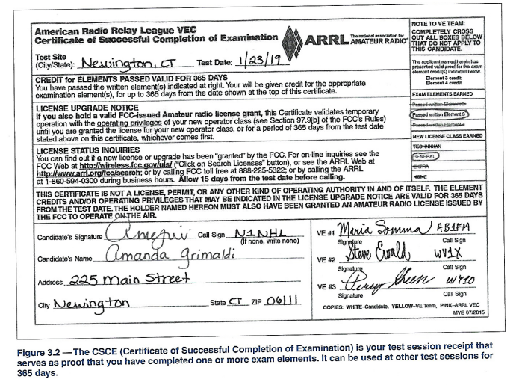
Sample CSCE

Slide 23
Credit for Previous Licenses
As of 2019, amateurs with expired licenses may receive credit for exam elements passed. Specifically …
If you pass Element 2 (tech) exam, and provide documentation for previously-held General, Advanced, or Amateur Extra licenses, you will be credited with having passed those written exam elements

Slide 24
PRACTICE QUESTIONS

Slide 25
Who may receive partial credit for the elements represented by an expired Amateur Radio license?
Any person who can demonstrate that they once held an FCC-issued General, Advanced, or Amateur Extra class license that was not revoked by the FCC
Anyone who held an FCC-issued Amateur Radio license that has been expired for not less than 5 years and not more than 15 years
Any person who previously held an amateur license issued by another country, but only if that country has a current reciprocal licensing agreement with the FCC
Only persons who once held an FCC issued Novice, Technician, or Technician Plus license
G1D01 (A) [97.501, 97.505(a)] Page 3-7
25

Slide 26
What license examinations may you administer as an accredited Volunteer Examiner holding a General class operator license?
General and Technician
None, only Amateur Extra class licensees may be accredited
Technician only
Amateur Extra, General, and Technician
G1D02 (C) [97.509(b)(3)(i)] Page 3-5
26

Slide 27
On which of the following band segments may you operate if you are a Technician class operator and have an unexpired Certificate of Successful Completion of Examination (CSCE) for General class privileges?
Only the Technician band segments until your upgrade is posted in the FCC database
Only on the Technician band segments until you have a receipt for the FCC application fee payment
On any General or Technician class band segment
On any General or Technician class band segment except 30 meters and 60 meters
G1D03 (C) [97.9(b)] Page 3-7
27

Slide 28
Who must observe the administration of a Technician class license examination?
At least three Volunteer Examiners of General class or higher
At least two Volunteer Examiners of General class or higher
At least two Volunteer Examiners of Technician class or higher
At least three Volunteer Examiners of Technician class
G1D04 (A) [97.509(3)(i)(c)] Page 3-5
28

Slide 29
Until an upgrade to General class is shown in the FCC database, when must a Technician licensee identify with “AG” after their call sign?
Whenever they operate using General class frequency privileges
Whenever they operate on any amateur frequency
Whenever they operate using Technician frequency privileges
A special identifier is not required if their General class license application has been filed with the FCC
G1D06 (A) [97.119(f) (2)] Page 3-7
29

Slide 30
Volunteer Examiners are accredited by what organization?
The Federal Communications Commission
The Universal Licensing System
A Volunteer Examiner Coordinator
The Wireless Telecommunications Bureau
G1D07 (C) [97.509(b)(1)] Page 3-4
30

Slide 31
Which of the following criteria must be met for a non-U.S. citizen to be an accredited Volunteer Examiner?
The person must be a resident of the U.S. for a minimum of 5 years
The person must hold an FCC granted Amateur Radio license of General class or above
The person’s home citizenship must be in ITU region 2
None of these choices is correct; a non-U.S. citizen cannot be a Volunteer Examiner
G1D08 (B) [97.509(b)(3)] Page 3-4
31

Slide 32
How long is a Certificate of Successful Completion of Examination (CSCE) valid for exam element credit?
30 days
180 days
365 days
For as long as your current license is valid
G1D09 (C) [97.9(b)] Page 3-7
32

Slide 33
What is the minimum age that one must be to qualify as an accredited Volunteer Examiner?
16 years
18 years
21 years
There is no age limit
G1D10 (B) [97.509(b) (2)] Page 3-4
33

Slide 34
What action is required to obtain a new General class license after a previously held license has expired and the two-year grace period has passed?
They must have a letter from the FCC showing they once held an amateur or commercial license
There are no requirements other than being able to show a copy of the expired license
Contact the FCC to have the license reinstated
The applicant must show proof of the appropriate expired license grant and pass the current Element 2 exam
G1D11 (D) [97.505] Page 3-7
34

Slide 35
Section 3.3 Control Operator Privileges & Rules
With so many new privileges, keep a reference handy (next slide)
When you tune bands, check to make sure you’re within the proper segment before transmitting (several questions on this)
Generals have FULL privileges on 160, 60, 30, 17, 12, and 10 meters
There are portions of 80, 40, 20, and 15 meters where Generals cannot transmit
Repeater operation on HF is limited on 10 meters from 29.6 to 29.7 MHz
Two HF bands have special regulations …
60 meters only permit channelized operation on USB, CW, and certain digital modes with power limit of 100 V ERP (effective radiated power)
30 meters permit only CW, RTTY, and data signals with limit of 200 W PEP

Slide 36
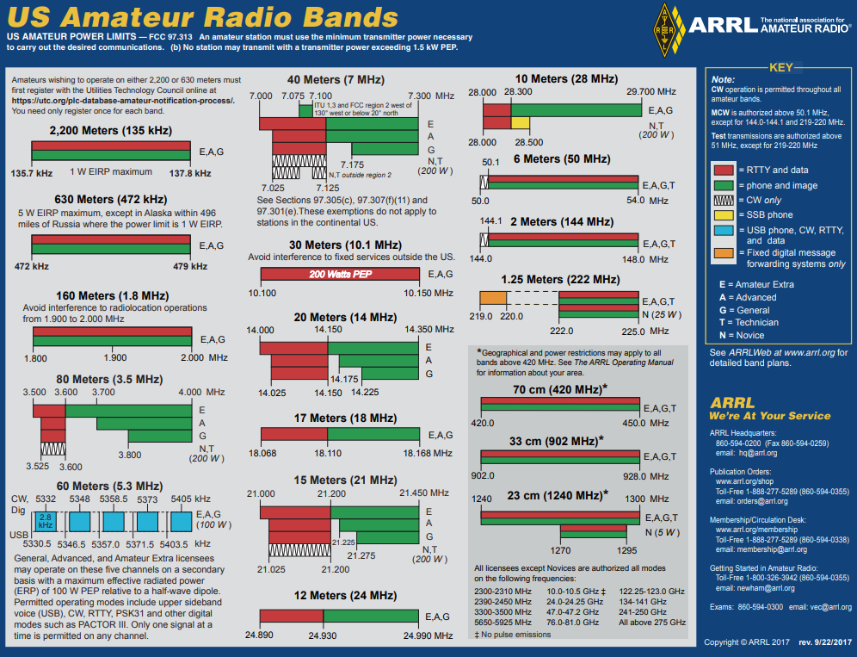
FREQUENCY PRIVILEGES
www.arrl.org/graphical-frequency-allocations

Slide 37
Control Operator Privileges & Rules (cont.)
In some bands, amateurs share access with other services
Called secondary amateur allocations (primary services have priority); the amateur station must clear the frequency
Hams are not allowed to contact the primary service
Example: Hams share part of the 13-cm spectrum with Wi-Fi channels, but amateurs may not communicate with unlicensed Wi-Fi stations
Amateurs are required to take special steps to mitigate interference in the following circumstances …
Operating within one mile of an FCC Monitoring Station
Transmitting spread spectrum (SS) emissions
Using a band where the Amateur Service is secondary

Slide 38
Beacons
Used for observation of propagation and reception and related activities
Useful on HF, VHF, and UHF bands
Beacon rules contained in §97.203 … most important ones …
No more than one signal in the same band from a single location
Limited to 100 W PEP output
Only HF band where automatically controlled beacons can operate: 28.2 to 28.3 MHz
Avoid transmitting on international beacon frequencies operated by Northern California DX Foundation (www.ncdxf.org)

Slide 39
Summary of Amateur HF Bands (Table 3.2)
WAVELENGTH (meters) | FREQUENCY (MHz)
160 | 1.800 – 2.00
80 and 75 | 3.500 – 3.600 and 3.600 – 4.000
60 | 5.3305, 5.3465, 5.3570, and 5.4035 (USB carrier frequency)
40 | 7.000 – 7.300
30 | 10.100 – 10.150
20 | 14.000 – 14.350
17 | 18.068 – 18.168
15 | 21.000 – 21.450
12 | 24.890 – 24.990
10 | 28.000 – 29.700
NOTE: On 60 meters, CW, and digital emissions must be centered 1.5 kHz above the carrier frequencies indicated above. Only one signal at a time is permitted on any channel.

Slide 40
PRACTICE QUESTIONS

Slide 41
On which HF and/or MF amateur bands are there portions where General class licensees cannot transmit?
60 meters, 30 meters, 17 meters, and 12 meters
160 meters, 60 meters, 15 meters, and 12 meters
80 meters, 40 meters, 20 meters, and 15 meters
80 meters, 20 meters, 15 meters, and 10 meters
G1A01 (C) [97.301(d)] Page 3-10
41

Slide 42
On which of the following bands is phone operation prohibited?
160 meters
30 meters
17 meters
12 meters
G1A02 (B) [97.305] Page 3-10
42

Slide 43
On which of the following bands is image transmission prohibited?
160 meters
30 meters
20 meters
12 meters
G1A03 (B) [97.305] Page 3-10
43

Slide 44
Which of the following amateur bands is restricted to communication only on specific channels, rather than frequency ranges?
11 meters
12 meters
30 meters
60 meters
G1A04 (D) [97.303 (h)] Page 3-10
44

Slide 45
On which of the following frequencies are General class licensees prohibited from operating as control operator?
7.125 MHz to 7.175 MHz
28.000 MHz to 28.025 MHz
21.275 MHz to 21.300 MHz
All of the above
G1A05 (A) [97.301(d)] Page 3-10
45

Slide 46
Which of the following applies when the FCC rules designate the amateur service as a secondary user on a band?
Amateur stations must record the call sign of the primary service station before operating on a frequency assigned to that station
Amateur stations may use the band only during emergencies
Amateur stations must not cause harmful interference to primary users and must accept interference from primary users
Amateur stations may only operate during specific hours of the day, while primary users are permitted 24-hour use of the band
G1A06 (C) [97.303] Page 3-10
46

Slide 47
On which amateur frequencies in the 10-meter band may stations with a General class control operator transmit CW emissions?
28.000 MHz to 28.025 MHz only
28.000 MHz to 28.300 MHz only
28.025 MHz to 28.300 MHz only
The entire band
G1A07 (D) [97.305(a)] Page 3-10
47

Slide 48
Which HF bands have segments exclusively allocated to Amateur Extra licensees?
All HF bands
80 meters, 40 meters, 20 meters, and 15 meters
All HF bands except 160 meters and 10 meters
60 meters, 30 meters, 17 meters, and 12 meters
G1A08 (B) [97.301(b)] Page 3-10
48

Slide 49
Which of the following frequencies is within the General class portion of the 15-meter band?
14250 kHz
18155 kHz
21300 kHz
24900 kHz
G1A09 (C) [97.301(d)] Page 3-10
49

Slide 50
What portion of the 10-meter band is available for repeater use?
The entire band
The portion between 28.1 MHz and 28.2 MHz
The portion between 28.3 MHz and 28.5 MHz
The portion above 29.5 MHz
G1A10 (D) [97.205(b)] Page 3-10
50

Slide 51
When General class licensees are not permitted to use the entire voice portion of a band, which portion of the voice segment is available to them?
The lower frequency portion
The upper frequency portion
The lower frequency portion on frequencies below 7.3 MHz, and the upper portion on frequencies above 14.150 MHz
The upper frequency portion on frequencies below 7.3 MHz, and the lower portion on frequencies above 14.150 MHz
G1A11 (B) [97.301] Page 3-10
51

Slide 52
With which of the following conditions must beacon stations comply?
No more than one beacon station may transmit in the same band from the same station location
The frequency must be coordinated with the National Beacon Organization
The frequency must be posted on the internet or published in a national periodical
All these choices are correct
G1B02 (A) [97.203(b)] Page 3-11
52

Slide 53
Which of the following is a purpose of a beacon station as identified in the FCC rules?
Observation of propagation and reception
Automatic identification of repeaters
Transmission of bulletins of general interest to amateur radio licensees
All these choices are correct
G1B03 (A) [97.3(a)9] Page 3-11
53

Slide 54
On what HF frequencies are automatically controlled beacons permitted?
On any frequency if power is less than 1 watt
On any frequency if transmissions are in Morse code
21.08 MHz to 21.09 MHz
28.20 MHz to 28.30 MHz
G1B09 (D) [97.203(d)] Page 3-11
54

Slide 55
What is the power limit for beacon stations?
10 watts PEP output
20 watts PEP output
100 watts PEP output
200 watts PEP output
G1B10 (C) [97.203(c)] Page 3-11
55

Slide 56
Which of the following conditions require a licensed amateur radio operator to take specific steps to avoid harmful interference to other users or facilities?
When operating within one mile of an FCC Monitoring Station
When using a band where the Amateur Service is secondary
When a station is transmitting spread spectrum emissions
All these choices are correct
G1E04 (D) [97.13(b), 97.303, 97.311(b)] Page 3-10
56

Slide 57
In what part of the 2.4 GHz band may an amateur station communicate with non-licensed Wi-Fi stations?
Anywhere in the band
Channels 1 through 4
Channels 42 through 45
No part
G1E07 (D) [97.111] Page 3-10
57

Slide 58
Why should an amateur operator normally avoid transmitting on 14.100, 18.110, 21.150, 24. 930 and 28.200 MHz?
A system of propagation beacon stations operates on those frequencies
A system of automatic digital stations operates on those frequencies
These frequencies are set aside for emergency operations
These frequencies are set aside for bulletins from the FCC
G1E10 (A) [97.101] Page 3-11
58

Slide 59
On what band do amateurs share channels with the unlicensed Wi-Fi service?
432 MHz
902 MHz
2.4 GHz
10.7 GHz
G8C01 (C) Page 3-10
59

Slide 60
Third-Party Traffic
Definition: Sending messages on behalf of someone else who is not an amateur
Foreign governments have an interest in limiting this because it bypasses normal Internet, telephone, and postal systems
FCC recognizes the value … wants people trained to provide effective emergency communications
Handling 3rd party messages is called passing traffic
3rd party traffic must be exchanged between amateur stations operating under FCC rules …
Non-commercial & either be personal and unimportant OR relating to emergencies or disaster relief

Slide 61
Third-Party Traffic (cont.)
3rd Party is the person or entity on whose behalf the message is being sent (may be an organization)
3rd Party does not need to be present
3rd party traffic CANNOT be exchanged on behalf of an amateur whose license has been suspended or revoked
Question arises … May third-party messages be transmitted via remote control?
YES: Under the same circumstances in which third party messages are permitted by FCC rules!
MORE INFO: www.arrl.org/third-party-operating-agreements

Slide 62
PRACTICE QUESTIONS

Slide 63
Which of the following would disqualify a third party from participating in sending a message via an amateur station?
The third party’s amateur license has been revoked and not reinstated
The third party is not a US citizen
The third party is speaking in a language other than English
All these choices are correct
G1E01 (A) [97.115(b) (2)] Page 3-13
63

Slide 64
What are the restrictions on messages sent to a third party in a country with which there is a Third-Party Agreement?
They must relate to emergencies or disaster relief
They must be for other licensed amateurs
They must relate to amateur radio, or remarks of a personal character, or messages relating to emergencies or disaster relief
The message must be limited to no longer than 1 minute in duration and the name of the third party must be recorded in the station log
G1E05 (C) [97.115(a) (2),97.117] Page 3-13
64

Slide 65
When may third-party messages be transmitted via remote control?
Under any circumstances in which third party messages are permitted by FCC rules
Under no circumstances except for emergencies
Only when the message is intended for licensed radio amateurs
Only when the message is intended for third parties in areas where licensing is controlled by the FCC
G1E12 (A) [97.115] Page 3-13
65

Slide 66
Prohibited & Restricted Communications
One-way transmissions not permitted, except for code practice
Can’t retransmit a broadcast, except for weather or propagation predictions from US government stations (as long as it’s occasional)
It’s permitted for US amateurs to communicate with amateur stations in countries outside the areas administered by the FCC unless the country has notified the ITU that it objects
Codes intended to obscure meanings of messages are prohibited

Slide 67
Prohibited & Restricted Communications (cont.)
On terrestrial cross-band repeaters that receive signals on one frequency band and retransmit them on another frequency band, such transmissions are permitted if the control operator of the repeater transmitter that operates on the HF band has a General class license or higher

Slide 68
PRACTICE QUESTIONS

Slide 69
Which of the following transmissions is permitted for all amateur stations?
Unidentified transmissions of less than 10 seconds duration for test purposes only
Automatic retransmission of other amateur signals by any amateur station
Occasional retransmission of weather and propagation forecast information from US government stations
Encrypted messages, if not intended to facilitate a criminal act
G1B04 (C) [97.113(c)] Page 3-14
69

Slide 70
Which of the following one-way transmissions are permitted?
Unidentified test transmissions of less than 10 seconds in duration
Transmissions to assist with learning the International Morse code
Regular transmissions offering equipment for sale, if intended for amateur radio use
All these choices are correct
G1B05 (B) [97.111(5)(b)] Page 3-14
70

Slide 71
What are the restrictions on the use of abbreviations or procedural signals in the amateur service?
Only “Q” signals are permitted
They may be used if they do not obscure the meaning of a message
They are not permitted
They are limited to those expressly listed in Part 97 of the FCC rules
G1B07 (B) [97.113(a)(4)] Page 3-14
71

Slide 72
When is it permissible to communicate with amateur stations in countries outside the areas administered by the Federal Communications Commission?
Only when the foreign country has a formal third-party agreement filed with the FCC
When the contact is with amateurs in any country except those whose administrations have notified the ITU that they object to such communications
Only when the contact is with amateurs licensed by a country which is a member of the United Nations, or by a territory possessed by such a country
Only when the contact is with amateurs licensed by a country which is a member of the International Amateur Radio Union, or by a territory possessed by such a country
G1B08 (B) [97.111(a)(1)] Page 3-14
72

Slide 73
When may a 10-meter repeater retransmit the 2-meter signal from a station that has a Technician class control operator?
Under no circumstances
Only if the station on 10-meters is operating under a Special Temporary Authorization allowing such retransmission
Only during an FCC-declared general state of communications emergency
Only if the 10-meter repeater control operator holds at least a General class license
G1E02 (D) [97.205(b)] Page 3-15
73

Slide 74
Section 3.4 Technical Rules and Standards
Good Amateur Practices …
Not all procedures are covered in the exam or by FCC Part 97 rules
Amateurs themselves set day-to-day operating standards, although the FCC reserves the right to rule on what is and isn’t good engineering and good amateur practice
Many sources available cover these practices, including …
ARRL Handbook
ARRL Antenna Book
Club websites

Slide 75
Output Power
General, Advanced, and Amateur Extra limited to max transmitter output of 1500 W PEP (peak envelope power) on HF bands
Two Q-signals for indicating power level …
QRP: Reduce power or I am using low power (usually 5W or less)
QRO: Increase power or I am using high power
Two max power restrictions on HF …
200 W PEP on 30 meters (10.1 MHz)
100 W PEP with respect to half-wave dipole on 60 meters (5 MHz) with max bandwidth of 2.8 kHz

Slide 76
Output Power (cont.)
Novice and Technician licensees operating on HF are limited to 200 W PEP output
General, Advanced, and Extra licensees may use full 1500 W PEP output in the former Novice segments on 80, 40, and 15 meters
Since spread spectrum creates a noise-like signal that can affect other users, the output power limit for amateurs for SS signals is 10 watts
FCC requires amateurs to use the minimum power necessary to carry out the desired communication

Slide 77
PRACTICE QUESTIONS

Slide 78
Who or what determines “good engineering and good amateur practice,” as applied to the operation of an amateur station in all respects not covered by the Part 97 rules?
The FCC
The control operator
The IEEE
The ITU
G1B11 (A) [97.101(a)] Page 3-15
78

Slide 79
What is the maximum transmitting power an amateur station may use on 10.140 MHz?
200 watts PEP output
1000 watts PEP output
1500 watts PEP output
2000 watts PEP output
G1C01 (A) [97.313(c) (1)] Page 3-16
79

Slide 80
What is the maximum transmitting power an amateur station may use on the 12-meter band?
50 watts PEP output
200 watts PEP output
1500 watts PEP output
An effective radiated power equivalent to 100 watts from a half-wave dipole
G1C02 (C) [97.313] Page 3-16
80

Slide 81
What is the maximum bandwidth permitted by FCC rules for Amateur Radio stations transmitting on USB frequencies in the 60-meter band?
2.8 kHz
5.6 kHz
1.8 kHz
3 kHz
G1C03 (A) [97.303(h) (1)] Page 3-16
81

Slide 82
What is the limit for transmitter power on the 28 MHz band for a General Class control operator?
100 watts PEP output
1000 watts PEP output
1500 watts PEP output
2000 watts PEP output
G1C05 (C) [97.313] Page 3-16
82

Slide 83
What is the limit for transmitter power on the 1.8 MHz band?
200 watts PEP output
1000 watts PEP output
1200 watts PEP output
1500 watts PEP output
G1C06 (D) [97.313] Page 3-16
83

Slide 84
What is the maximum power limit on the 60-meter band?
1500 watts PEP
10 watts RMS
ERP of 100 watts PEP with respect to a dipole
ERP of 100 watts PEP with respect to an isotropic antenna
G1C09 (C) [97.313(i)] Page 3-16
84

Slide 85
What measurement is specified by FCC rules that regulate maximum power?
RMS output from the transmitter
RMS input to the antenna
PEP input to the antenna
PEP output from the transmitter
G1C11 (D) [97.313] Page 3-16
85

Slide 86
What is the maximum PEP output allowed for spread spectrum transmissions?
100 milliwatts
10 watts
100 watts
1500 watts
G1E08 (B) [97.313(j)] Page 3-16
86

Slide 87
What is QRP operation?
Remote piloted model control
Low-power transmit operation
Transmission using Quick Response Protocol
Traffic relay procedure net operation
G2D10 (B) Page 3-16
87

Slide 88
Digital Transmissions
FCC rules for digital transmissions are primarily concerned with the bandwidth of the transmitted signal
Bandwidth is tied to the symbol rate … signal events per second
Covered in §97.305(c) and §97.307(f) … see Table 3.4 (next slide)
As the size of the amateur bands increases with frequency, faster (wider) signals are allowed
At 33 cm (902 MHz) and above, there is no limit except for the band edges themselves

Slide 89
Max Symbol Rates & Bandwidth (Table 3.4)
BAND | SYMBOL RATE (baud) | BANDWIDTH (kHz)
160 thru 12 m | 300 | 1
10 m | 1200 | 1
6 m, 2 m | 19.6k | 2
1.25 m, 70 cm | 56k | 100
33 cm and above | No limit | No limit
There are new protocols being introduced all the time. The FCC recognized the need for amateurs to receive and understand signals must be balanced with the benefits of innovation. This is why the FCC requires the technical characteristics of the protocol be publicly documented before using it on the air.

Slide 90
PRACTICE QUESTIONS

Slide 91
What must be done before using a new digital protocol on the air?
Type-certify equipment to FCC standards
Obtain an experimental license from the FCC
Publicly document the technical characteristics of the protocol
Submit a rule-making proposal to the FCC describing the codes and methods of the technique
G1C07 (C) [97.309(a)(4)] Page 3-17
91

Slide 92
What is the maximum symbol rate permitted for RTTY or data emission transmitted at frequencies below 28 MHz?
56 kilobaud
19.6 kilobaud
1200 baud
300 baud
G1C08 (D) [97.307(f)(3)] Page 3-17
92

Slide 93
What is the maximum symbol rate permitted for RTTY or data emission transmissions on the 10-meter band?
56 kilobaud
19.6 kilobaud
1200 baud
300 baud
G1C10 (C) [97.305(c) and 97.307(f)(4)] Page 3-17
93

Slide 94
END OF CHAPTER 3 PART 1 OF 1
94

Slide 95
Slides created by …
Jerry D. Kilpatrick
KØILP (Amateur Radio)
PGØØØ72373 (Commercial Operator)
K0ILP.NC@gmail.com
Feel free to contact me if you find errors or have suggestions for improvement.

